Slide 1
Super Market Sales Analysis
Case study on analyzing the data set of a retail industry named as super market store(e-commerse)

Slide 2
CASE STUDY
Total sales attain by the market and find which category has the highest sales.
Show the profit of the super market from the year 2016 – 2019.
Visualizing the sales and profit of the super market data using scatter plot, visualize how well they scattered among states and region.
Which state has the highest sales in united states and visualize the sales that attain by the other states using heat map.
Which state has the highest profit.
Visualize the sum of sales that occurred in the regional area of the united states in every quarter of the each year.
Visualize the sum of sales and profit of the sub category column and analyze how they distributed.

Slide 3
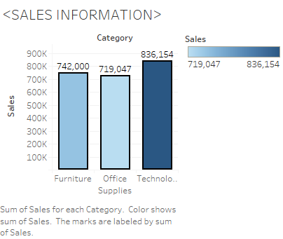
SALES DATA Technology category has the highest sales of 836,154K Here we can get the information that people in U.S will always prefer to buy products related to technology.

Slide 4
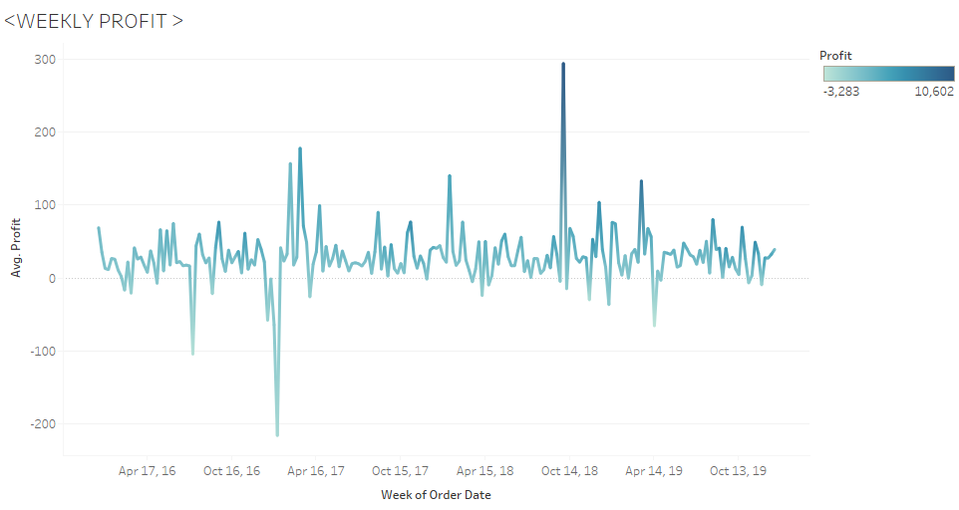
Weekly Profit
Here we acquire that the last week of September 2018 has the highest average profit of 294.5K.
Where as the last third week of January 2017 has the lowest average profit of -216.13K

Slide 5
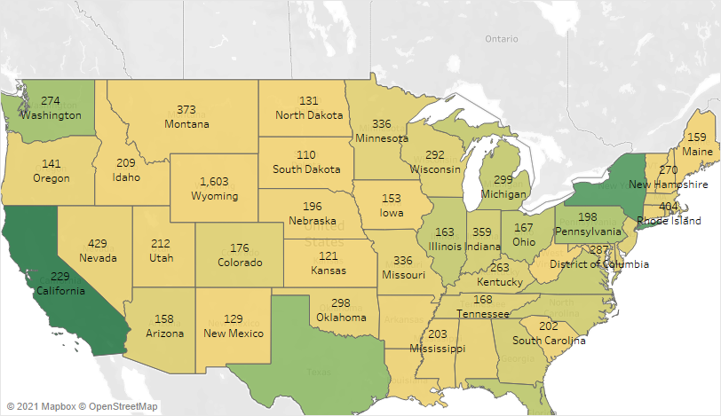
Washington has the highest average sales of 274K and California the highest sales of 457.688K

Slide 6
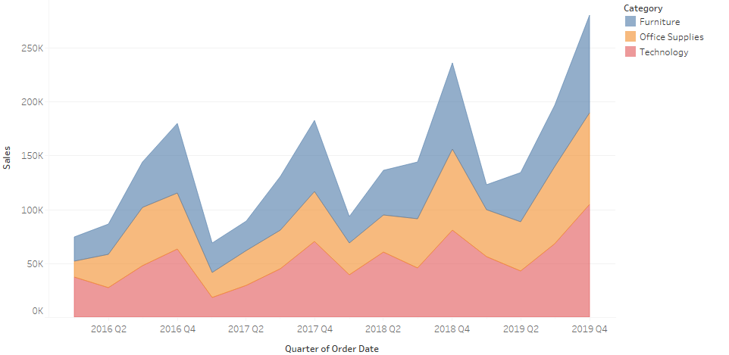
The categories like Furniture, Office Supplies and Technology has attain their highest sales at the 2019 Quarter 4.

Slide 7
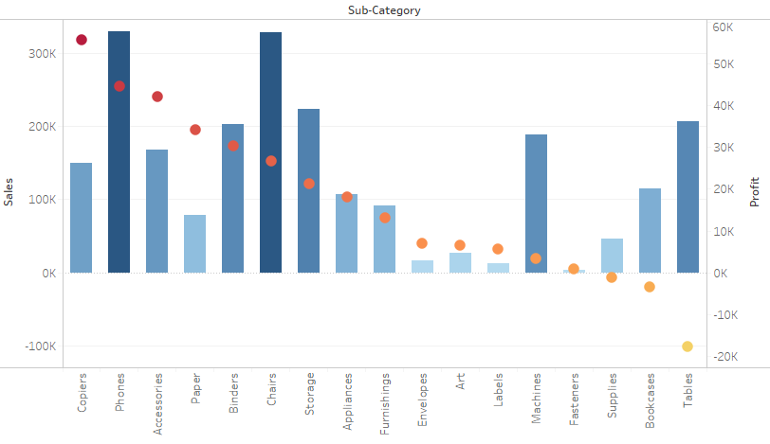
The sub category Copiers has the highest average profit of amount of 817.9K and the Tables sub category has the lowest average profit of -55.6K.

Slide 8
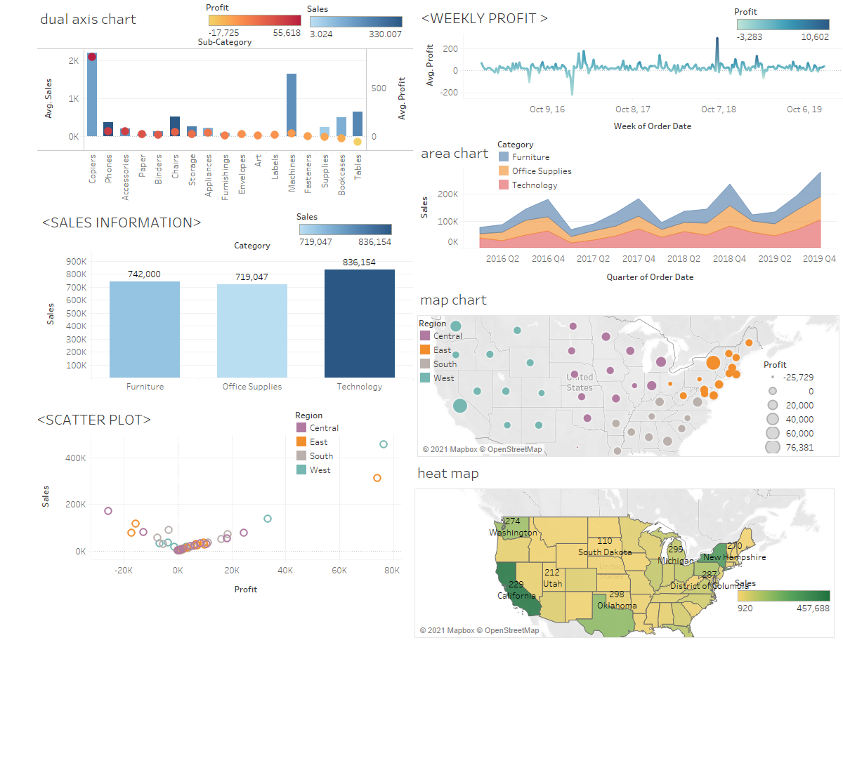
DASHBOARD

Slide 9
CONCLUSION
It shows that the U.S people are interested in buying technology products other than furniture and office supplies.
The central region of the U.S state has the lowest sales, this shows the people in that area are not showing the interest to buy the costly products.
The people around the market is not willing to buy tables so the company should consider this and find some other product which will improve the profit of the company.

